Slide 1


Grams- Schmidt in 9 Lines of MATLAB.
Here is a 9-line MATLAB code to build Q and R from A. Start with [m,n]=size(A); Q=zeros(m,n); R=zeros(n,n);to get the shapes correct.
>> for j=1:n % Grams-Schmidt orthogonalization
>> v=A(: , j); % v begins as column j of A
>> for i=1:j-1
>> R(i,j)=Q(:,i)’*A(:,j); % modify A(:,j) to v for more accuracy
>> v=v-R(i,j)*Q(:,i); % subtract the projection
>> end % v is now perpendicular to all of q1,…qj-1
>> R(j,j)=norm(v);
>> Q(:,j)=v/R(j,j); % normalize v to be the next unit vector qj
>> end

Slide 2
Grams- Schmidt Orthogonalization process continued..
Example:
Apply the Gram-Schmidt process to the vectors (1,0,1), (1,0,0) and (2,1,0) to produce a set of Orthonormal vectors.
>> A=[1,1,2;0,0,1;1,0,0]
>> Q=zeros(3)
>> R=zeros(3)
>> for j=1:3
>> v=A(: , j)
>> for i=1:j-1
>> R(i,j)=Q(:,i)'*A(:,j)
>> v=v-R(i,j)*Q(:,i)
>> end
>> R(j,j)=norm(v)
>> Q(:,j)=v/R(j,j)
>> end

Slide 3
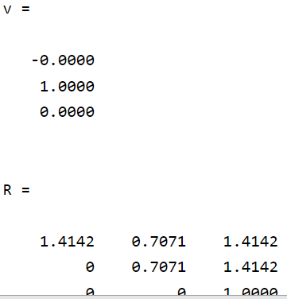
Grams- Schmidt Orthogonalization process continued..
Output:

Slide 4
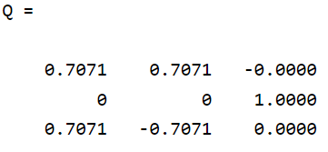
Grams- Schmidt Orthogonalization process continued..
.Output:

Slide 5
Grams- Schmidt Orthogonalization process continued..
2. Apply the Gram-Schmidt process to the vectors a=(0,1,1,1),
b=(1,1,-1,0) and c=(1,0,2,-1).
>> A=[0,1,1;1,1,0;1,-1,2;1,0,-1]
>> Q=zeros(4,3)
>> R=zeros(3)
>> for j=1:3
>> v=A(: , j);
>> For i=1:j-1
>> R(i,j)=Q(:,i)'*A(:,j)
>> v=v-R(i,j)*Q(:,i)
>> end
>> R(j,j)=norm(v)
>> Q(:,j)=v/R(j,j)
>> end
.

Slide 6
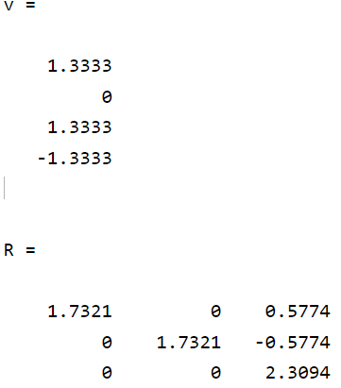
Grams- Schmidt Orthogonalization process continued.. Output:

Slide 7
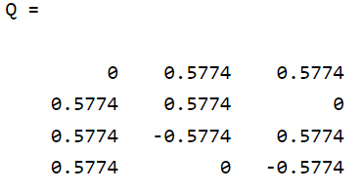
Grams- Schmidt Orthogonalization process continued..

